Slide 1


A Journey to a Security Mindset
Threat Modeling on the Family Road Trip
Notes:
A little tongue in cheek but just an interesting way to explore the various levels of security mindedness

Slide 2
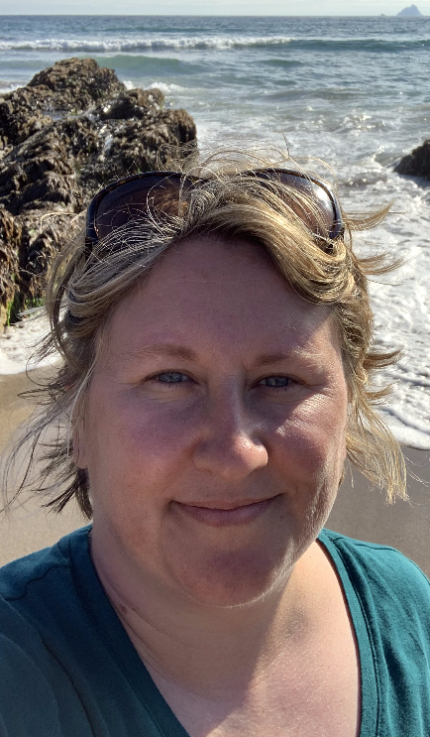



Hello!
I’m Angela Pinney
Senior Application Architect
Applied Systems, Inc.
@apcacher
Notes:
All thoughts are my own
All photos are my own unless otherwise noted
Applied Systems is a leading provider of software that powers the business of insurance.
I love to travel and I’ve been on oh so many road trips with my big blended family

Slide 3
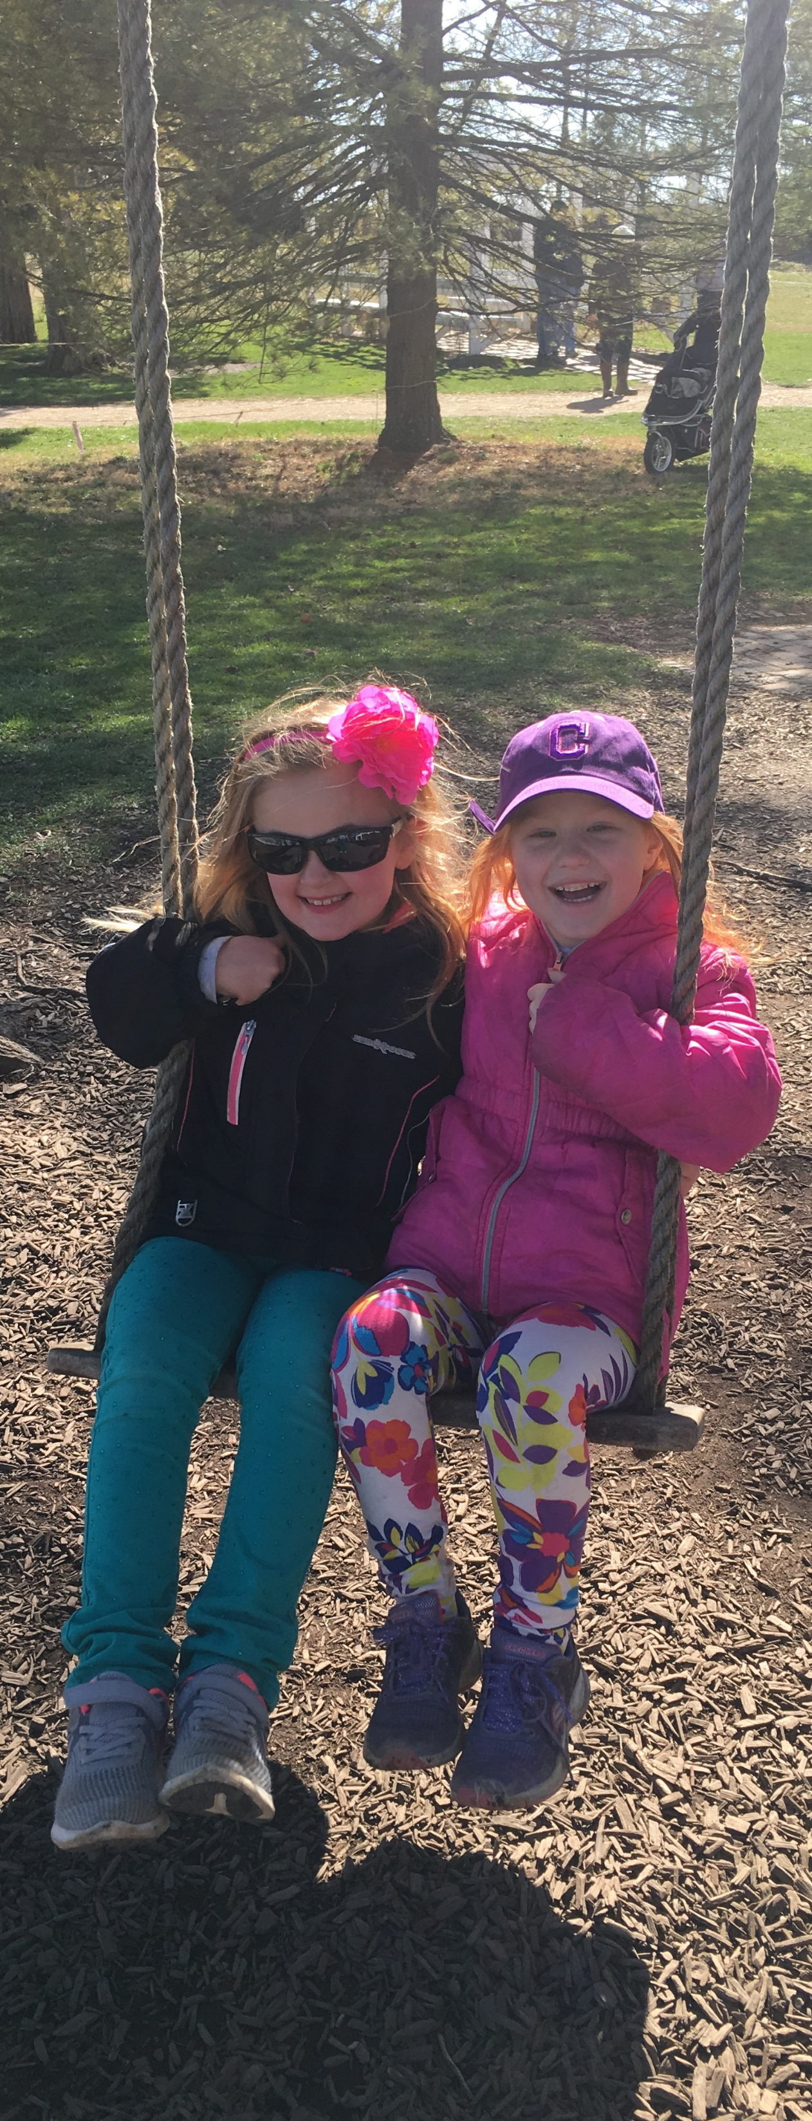
You Are All Responsible for Security
Let’s Make Friends
Executives/ Leaders
Engineers Software
DevOp
System
Security
Product Managers/Owners
Quality Assurance
DON’T LEAVE
Notes:
We can’t rely on one group to own security. It just doesn’t work.
We need our leaders to own it, all of our engineers (application, operations, DevOps, etc), our Product Owners need to own it and then lastly we can bring those Security folks in for their expertise
Everything is better when you share ☺

Slide 4
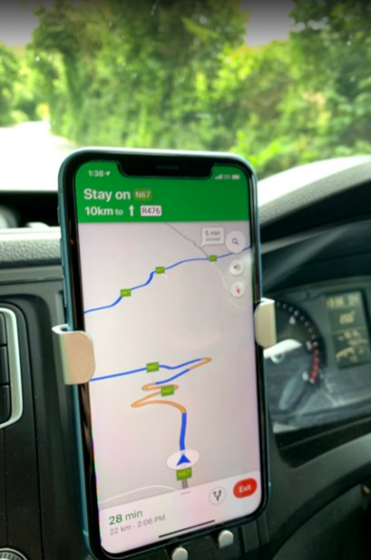
Road Tripping to a Security Mindset
with 5 tips for success

Slide 5
Know your Destination
1
(and bring snacks)

Slide 6
PRO TIP: SNACKS
Notes:
everyone wants their own snacks. a good metaphor - you are going to come across a lot of different products and solutions. You can't require everyone to adopt the same tools and solutions but good security practices apply across the board.

Slide 7
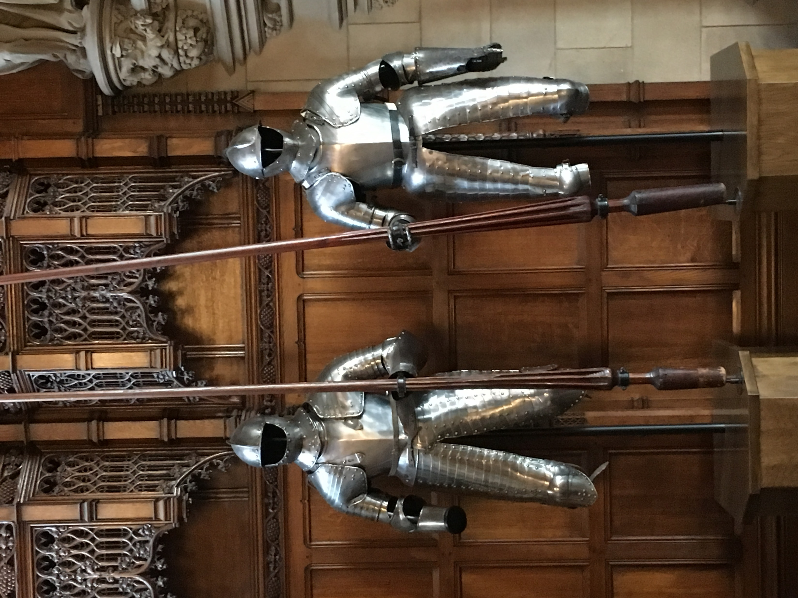
A Secure System
What is it
&
When do we need it?
Notes:
What words do you think of when you’re thinking about a secure system? How would you describe it?

Slide 8

A secure system is one that does what it is supposed to do, and nothing more.
Quote by: John B. Ippolito, CISSP
Notes:
I liked this really simple definition of a secure system. It might pivot how we think about securing our systems.

Slide 9
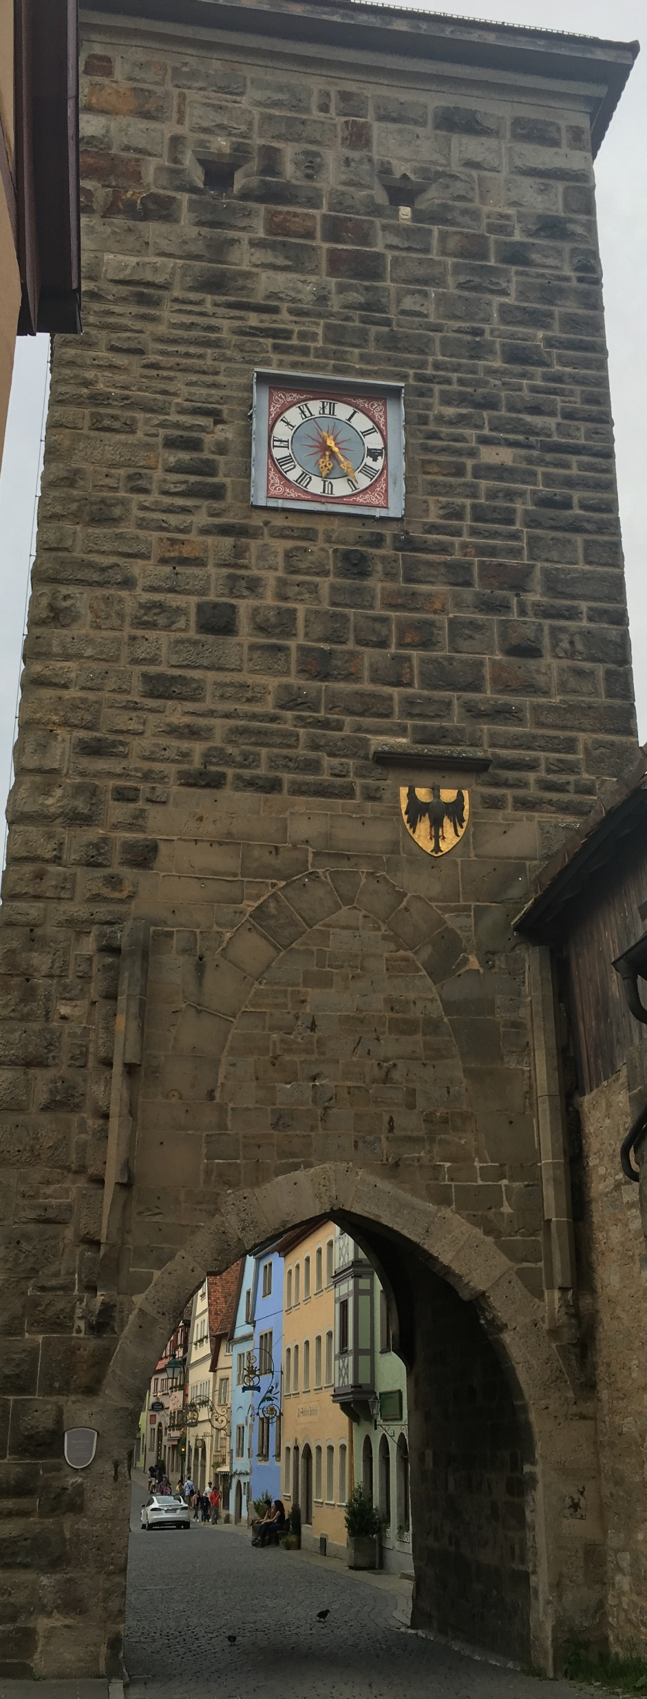
What should be secured?
Common Business Systems (email, db server)
Systems that contain important data - financial, health, PII (Personally Identifiable Information)
Apps targeted or attractive to children
Anything on the internet
Software that downloads updates
Pretty much everything
*Source: Microsoft Security Development Lifecycle
Notes:
From the Microsoft Security Development Lifecycle
Contrary to the belief of some, we are most likely not developing an application that doesn’t need to be properly secured

Slide 10
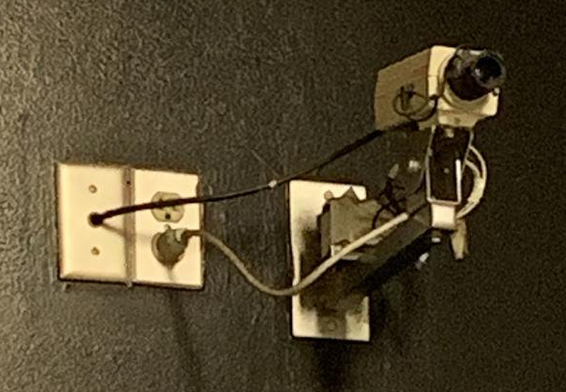

Just using Security Features is not Enough!
*Photo credit: Twitter (unknown source)

Slide 11
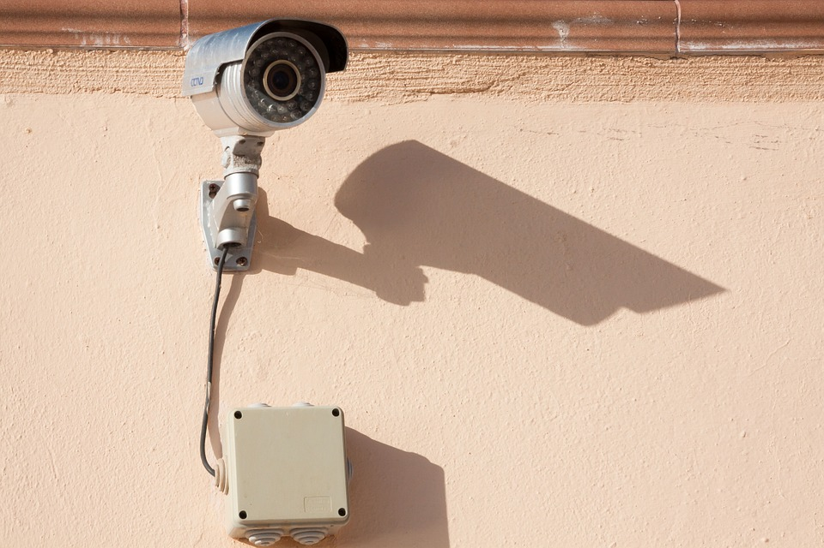
Reminder: Just using Security Features is not Enough!
This Photo by Unknown Author is licensed under CC BY
Notes:
They must be implemented securely as well.

Slide 12
What is adopting a Security Mindset?
Protecting Sensitive Data
Following Least Privilege
Holding High Standards
Understanding and Embracing Security Policy
Challenging Assumptions
Seeking to Know More about Security
Teaching Others What You Know
Notes:
This talk is about a Journey to a Security Mindset
Let’s talk a minute about what I mean by a Security Mindset
-our system does need to be secured
-the policy exists for a reason – we should not be fighting it or trying to work around it
-challenge assumptions like “the post is secure”
-least privilege will make things less easy. That doesn’t mean we shouldn’t be doing it.
-educating yourself, being aware
-not just teaching formally but informally. When your buddy sends out a password in an email, remind them that it’s not a secure means for transferring that information

Slide 13
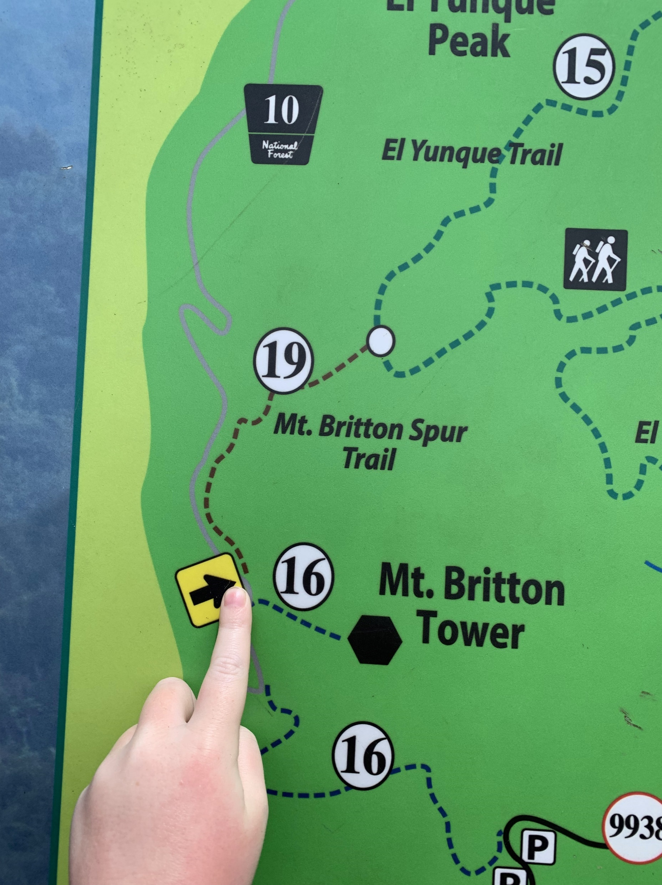
Road Trip Lesson #1
Don’t lose sight of your destination.
Notes:
No one wants hangry participants.
The best idea I ever had was personalized snack bags for a long car ride. It will change your life.

Slide 14
Read the Signs
2

Slide 15
TRANSLATION TOOLS
Notes:
When traveling to a new country, consider using translation tools or finding a book that talks about road signs. I have driven across a pedestrian bridge and up an exit ramp (2 different countries) due to lack of thoughtful planning here.

Slide 16
A Case Study: Virgin Media
Telecom company
Servicing the UK
4.8 million customers
Subsidiary of Liberty Global
Publicly traded
Revenue of $11.9B in 2018
20,000 employees
25 million customers
Notes:
Here is our case study – I’ll give you a minute just to read this twitter thread from this year.

Slide 17
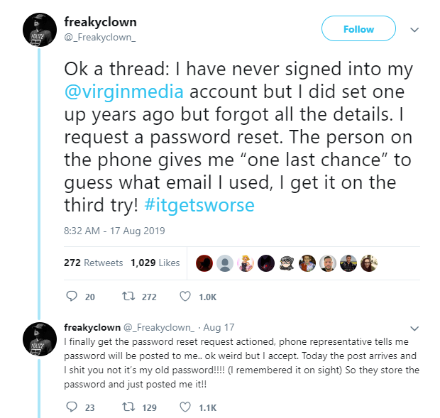
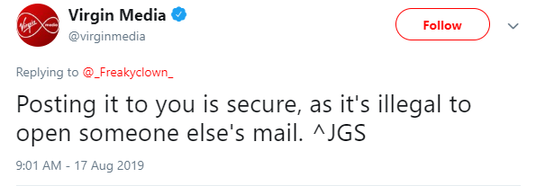
A Case Study
Notes:
Here is our case study – I’ll give you a minute just to read this twitter thread from last month.

Slide 18
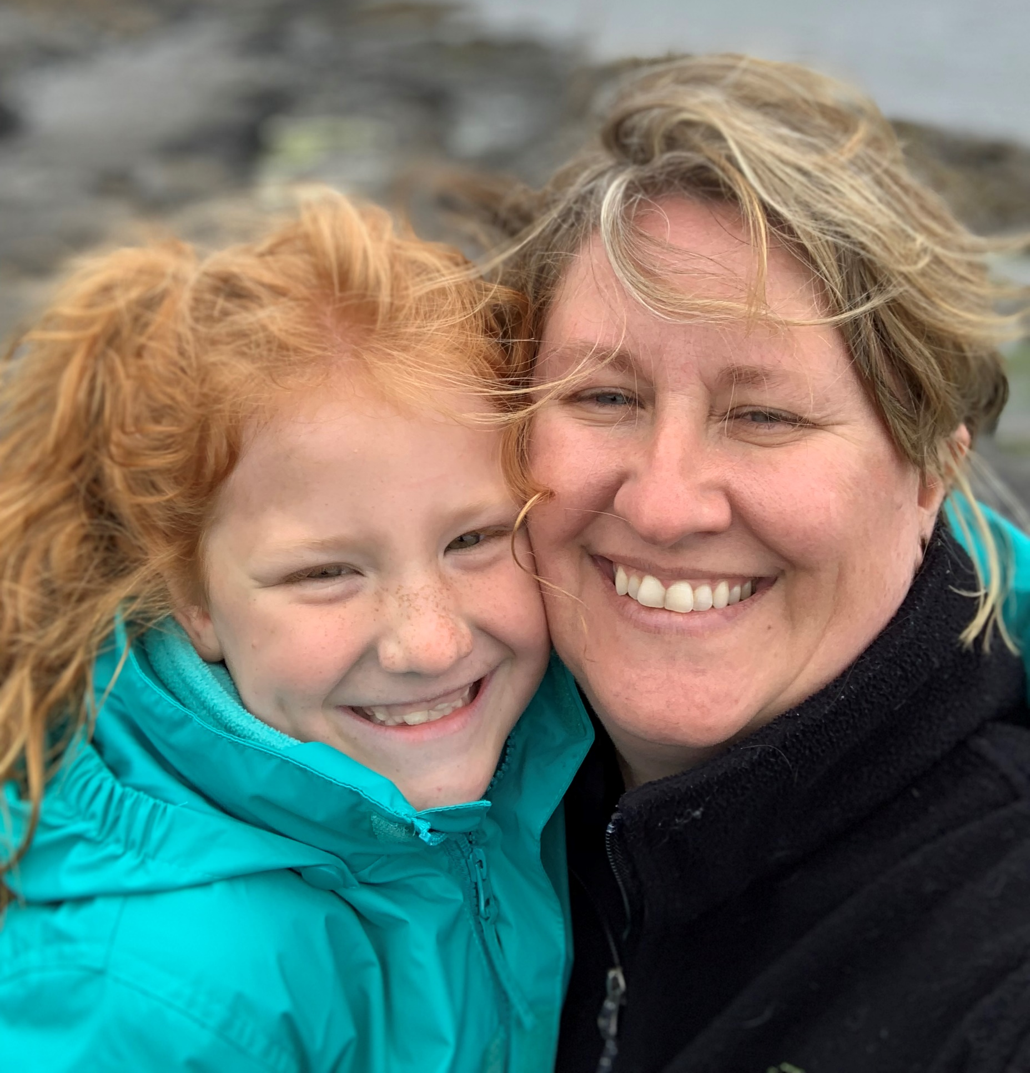
“They are SO nice!”
-7 year old
Notes:
So now we begin on our journey. First up, from the third row, is the 7 year old. She notices these things. Here thoughts are…
So clearly, this company is all about customer service – that IS nice.

Slide 19
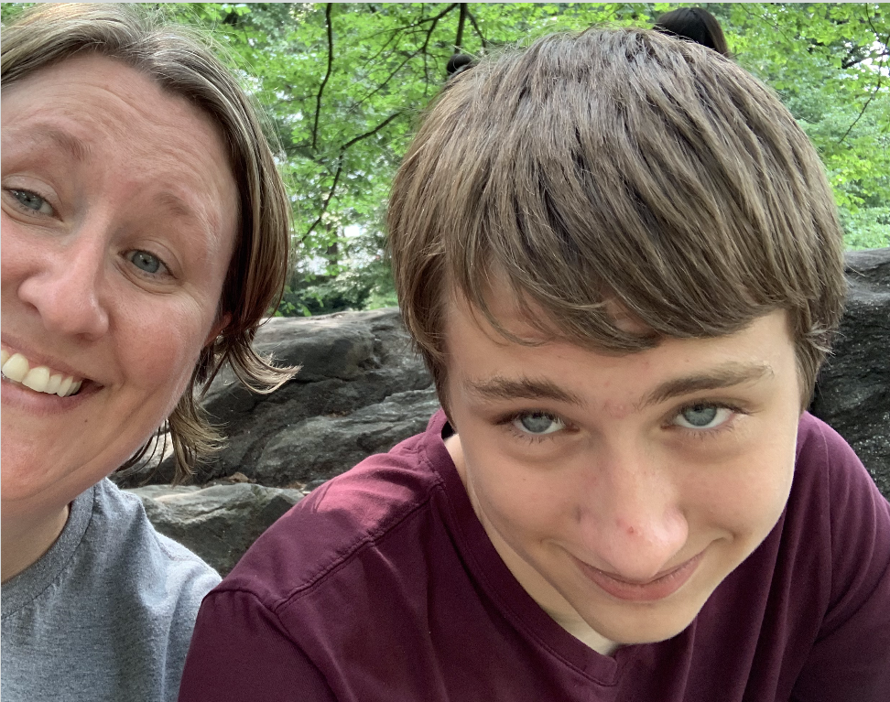
“Uh…Just because it’s illegal doesn’t mean people don’t do it.”
-13 year old
Notes:
Next up, is the 13 year old. The legality pops right out to him. His thoughts… So clearly a little more security minded. He sees that activity being illegal doesn’t stop people.

Slide 20

“This is why I’m not on social media.”
-Anonymous
Notes:
Moving along we have an anonymous car rider who looks closely at the three guesses to guess the email on the account. Their feedback…
This rider knows that social engineering is the biggest security threat that systems face. And they know the less of a footprint they leave, the less ammo there is.
A little humor but also some recognition that the more information out there on the internet about someone, the easier it is to employ social engineering tactics to compromise systems, right?

Slide 21
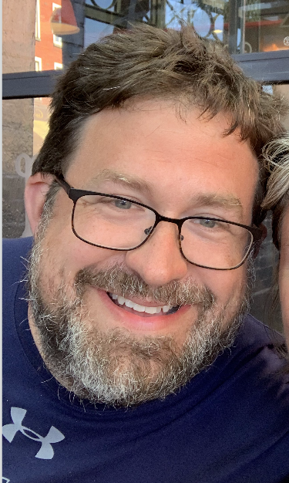
“They store their passwords in plain text? Geesh.”
- 40+ year old IT Professional
Notes:
Next up, from the passenger seat (because you know I’m driving the car) is the 40-something year old IT professional.
What he notices right away is maybe what you also noticed…
Clearly some experience here with the right way to secure passwords and such

Slide 22
“Well, if you didn’t re-use passwords, this wouldn’t be a problem.”
- Bunches of Tweeple
Notes:
So next up, participating virtually in our journey are the folks responding to the thread on twitter. A number of them really seemed to latch onto this… the Password. And their thoughts were…
And at this point, I drove off the road.
Hundreds of people focusing on a element here that clearly is not the point of the freaky clown… and assuming that no one ever re-uses passwords. That’s not good security practice.
We can all assume people will all use a unique password to our system, right? Do YOU use a unique password to every system you use? If so, good for you.

Slide 23
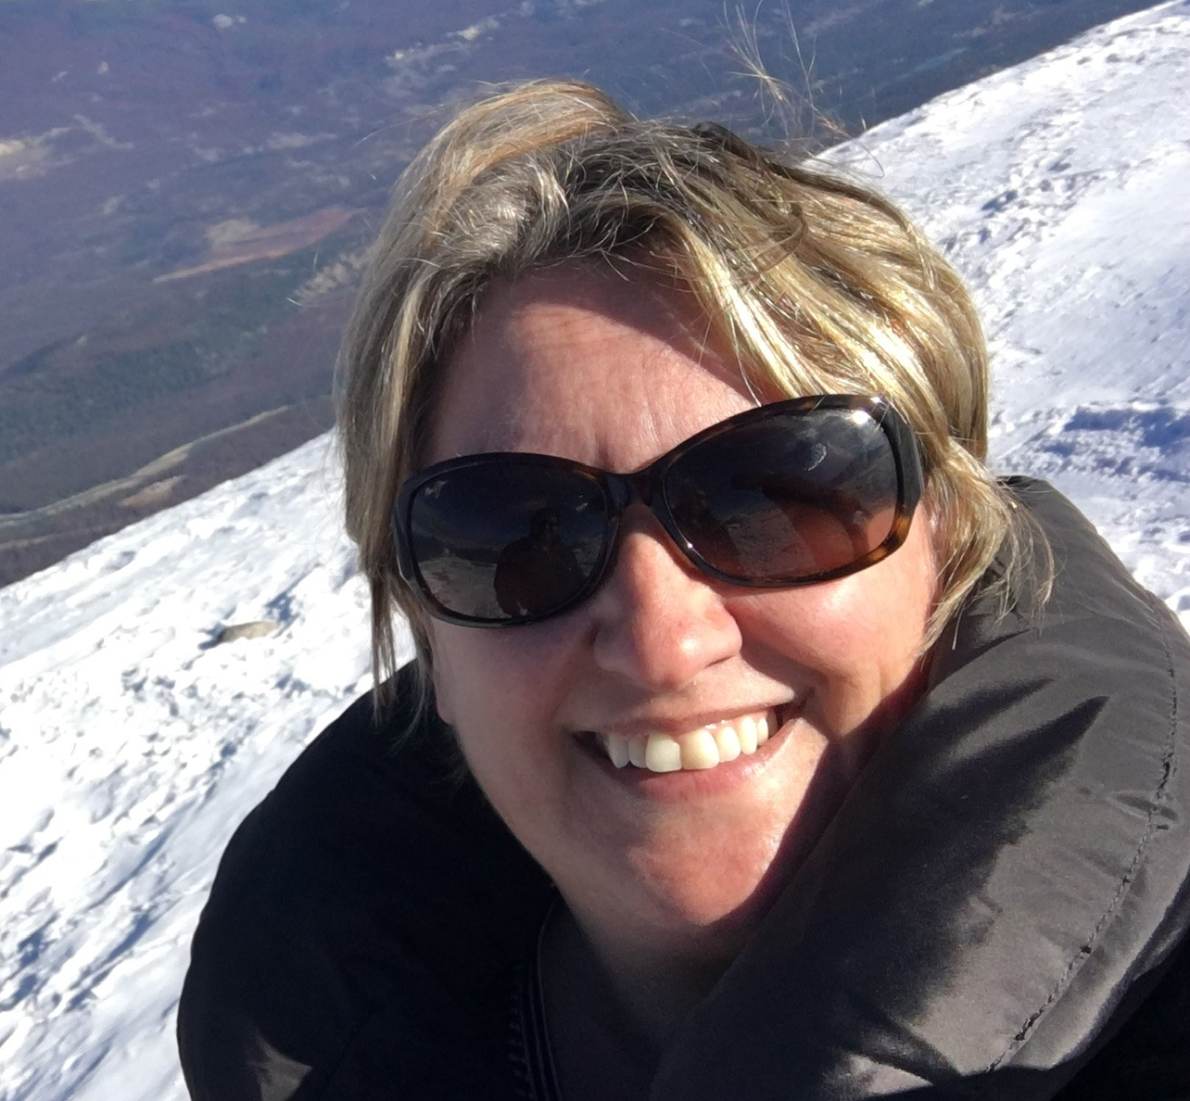
“The signs are pointing to a systemic problem
here.”
- Me
Notes:
Ok after we get the car back on the road, I start looking at this thread.
Their customer support team is subject to social hacking, their engineering team isn't using common practice hashing standards for passwords, their entire business team isn't handling private data appropriately (how many people touched that piece of mail?), and their social media team tweets things like this.
Virgin Media – you’ve got a problem. This isn’t an anomaly or a bump in the road. Pick your metaphor. This is a car-sucking pothole or an all-points bulletin roadblock.

Slide 24
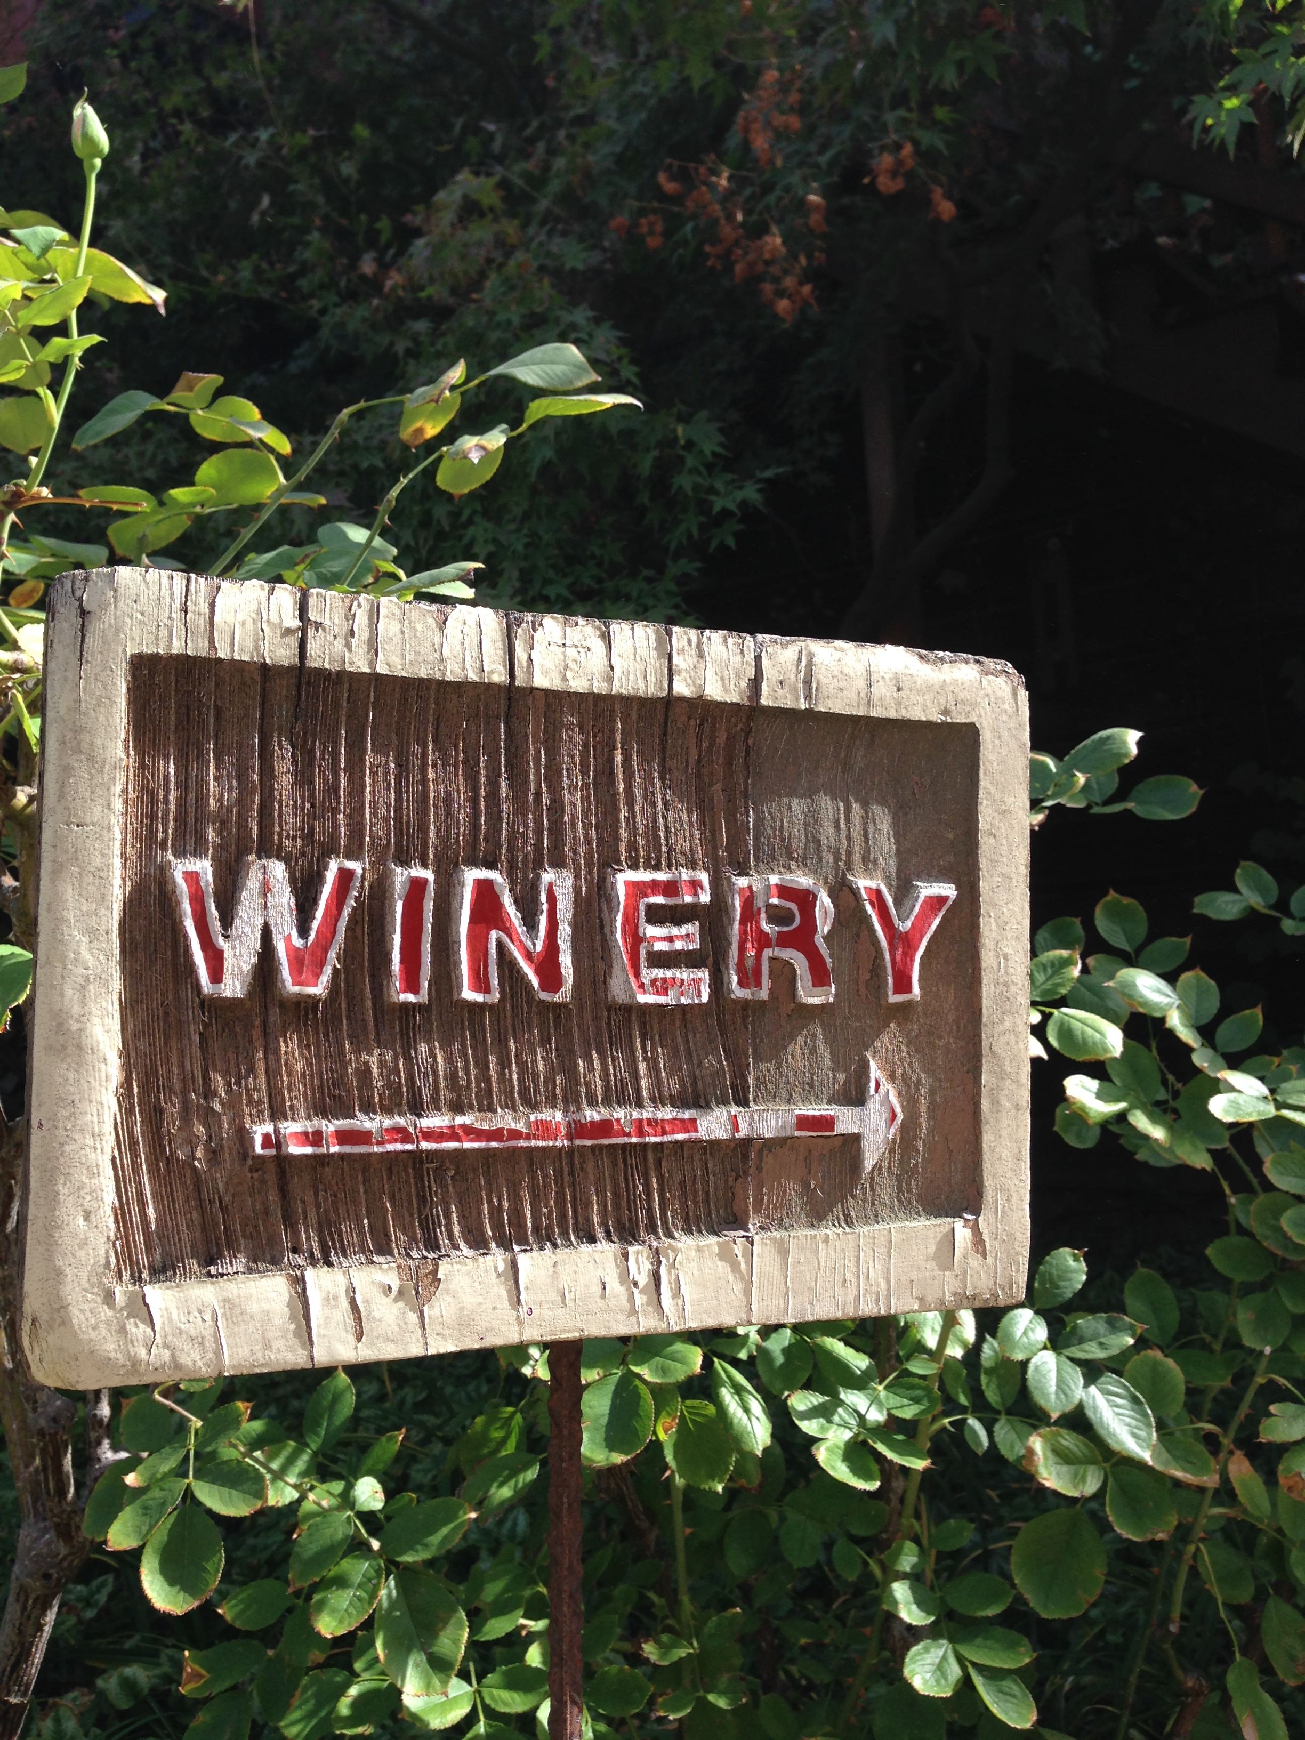
Road Trip Lesson #2
Use the signs to learn a new route.

Slide 25
Learn new things
3

Slide 26
Did you know?

Slide 27
Failure to give attention to the area of security training puts an enterprise at great risk because security of agency resources is as much a human issue as it is a technology issue.
*Source: NIST SP 800-50
Notes:
Seek Knowledge

Slide 28
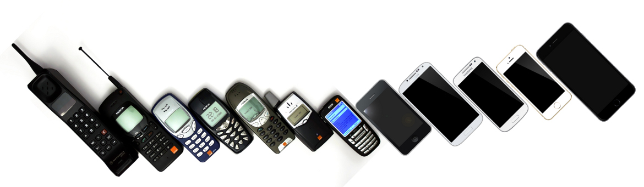
A Case Study – The Evolution of Securing a Mobile Device
A.K.A. There is no privacy in a family of 6
This Photo by Unknown Author is licensed under CC BY

Slide 29

Security Mindset O Meter
14yo: Is your iPad passcode still all 6s?
7y: Not anymore. <giggle, giggle>
14yo: 7777777
Lesson Learned: Users cannot be trusted. Neither can siblings.
This Photo by Unknown Author is licensed under CC BY-SA

Slide 30
Security Mindset O Meter
Me: Hey, What’s your passcode?
14y: I’m not telling you
Me: Does your dad know?
14y: Yes.
Me: Cool. Dad, what’s the passcode?
Lesson Learned: Do Not Assume. You know what happens.
This Photo by Unknown Author is licensed under CC BY-SA

Slide 31
Security Mindset O Meter
13y: Can I watch a show on your phone?
Me: No.
13y: What’s your passcode?
Me: No.
13y: [holds phone in front of my face to unlock]
Lesson Learned: Security features are not always secure.
This Photo by Unknown Author is licensed under CC BY-SA

Slide 32
Security Mindset O Meter
Anonymous: I’m never using the biometric features. You can change a password or code, but I’m not getting plastic surgery to change my facial recognition!

Slide 33
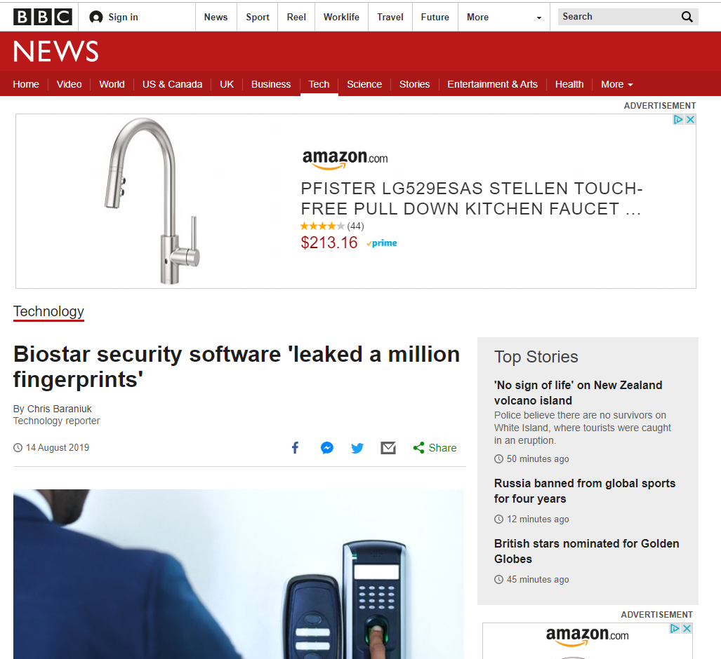
Lesson Learned: Yesterday’s solution is tomorrow’s threat. Always be learning.

Slide 34
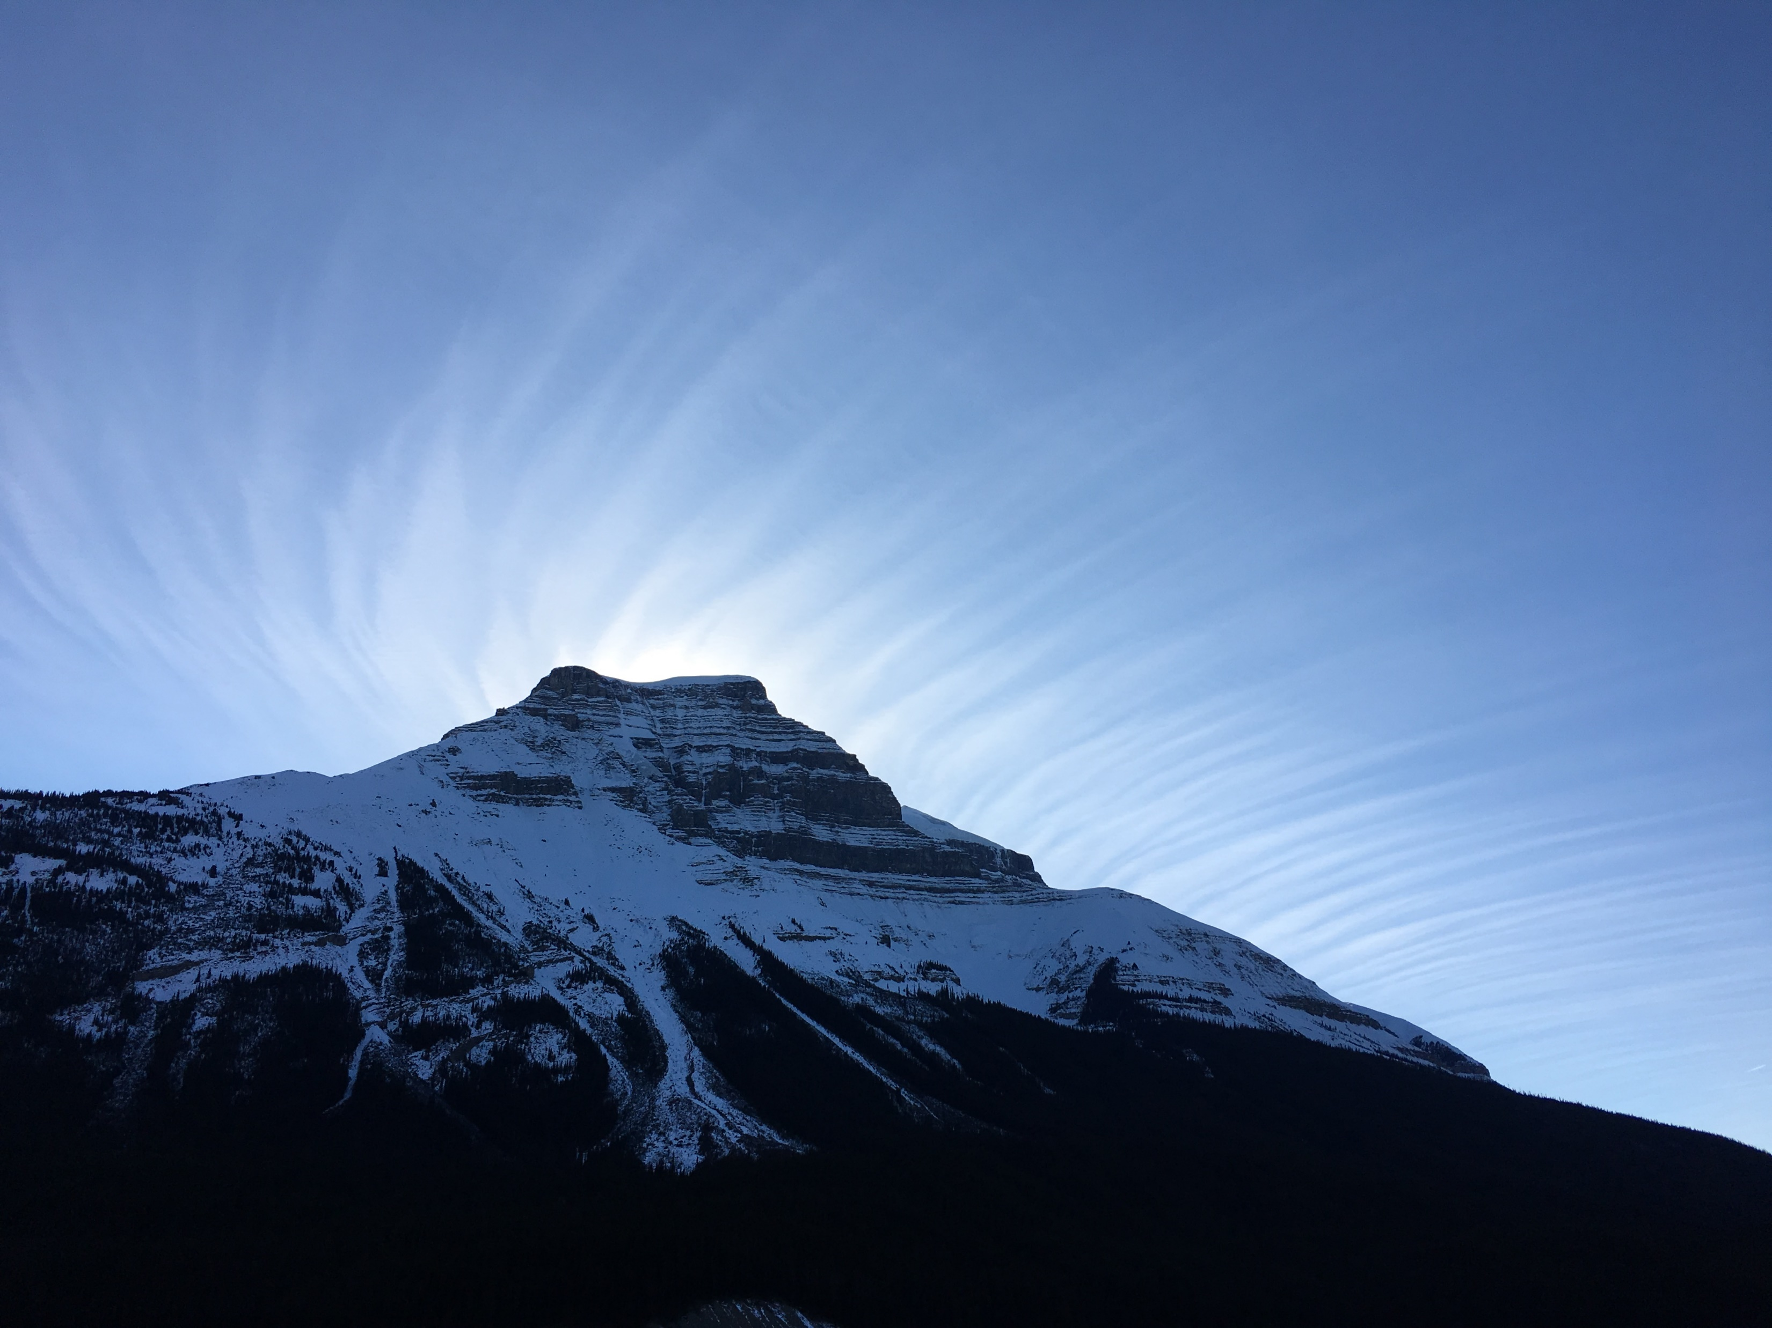
Road Trip Lesson #3
There is always more to know.

Slide 35
Knowledge is Key What we don’t know hurts us every day.
Notes:
Seek Knowledge
-Go to conference talks
-Read blogs
-Attend local meet ups
-Use online learning resources
-Follow security folks on Twitter
-Experiment – run a vulnerability scan and seek to understand the results
-Ask Questions

Slide 36
Bring Friends
4
(or your kids)

Slide 37
Minivans

Slide 38
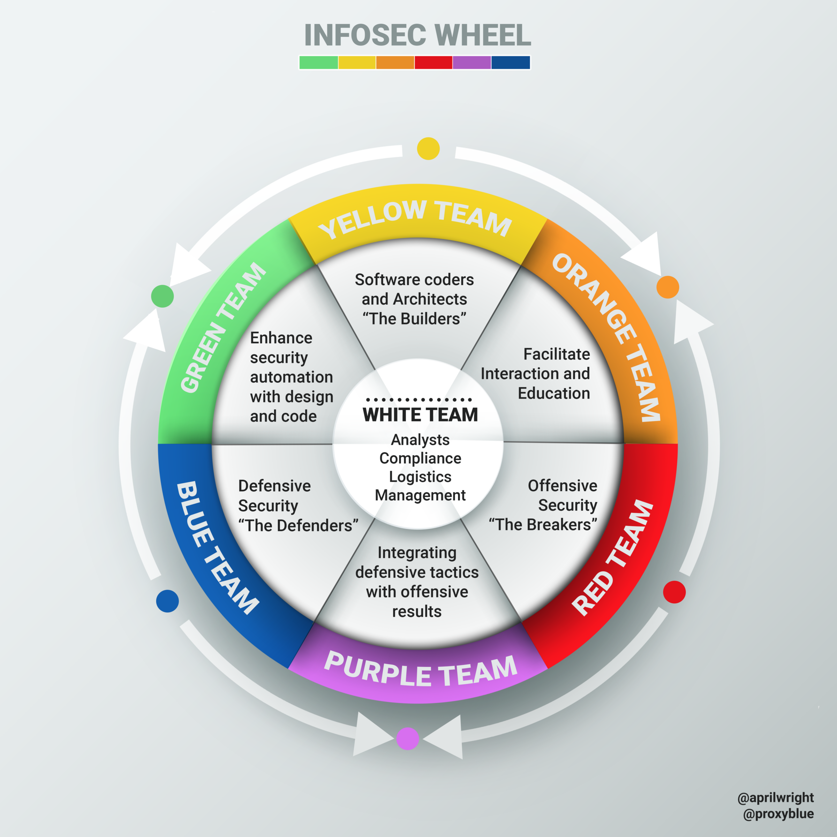
Everyone has a role
The Builders
The Defenders
The Breakers
The Advisors
*Source: April Wright via Louis Cremen
Notes:
In her talk Orange is the New Purple, April Wright introduced the concept and Louis Cremen here gave us this night graphic

Slide 39
My Minivan Riders

Slide 40
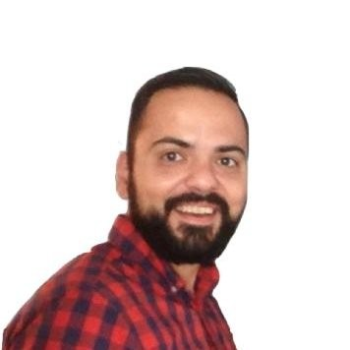
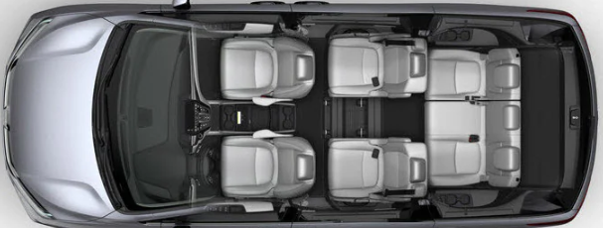
Israel’s Mission
Understand user personas
Offer the highest quality product
Create market-relevant products
Retain existing customers
Guard the reputation of the company
Israel
Product Manager
*Source: Delray Honda

Slide 41
Israel’s Security Mindset
Identify security and quality criteria for all work
Balance security features with user practices
Make security a selling feature
Make a business case for security investment
Stay abreast of compliance requirements
Israel
Product Manager

Slide 42
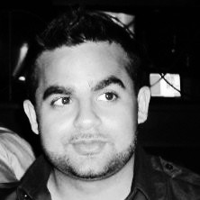
Tehseen’s Mission
Modernize our practices
Eliminate one-offs
Avoid manual work
Evangelize automation
Tehseen
DevOps
Engineer

Slide 43
Tehseen’s Security Mindset
Highlight how automation provides security protection
Teach others to automate
Eliminate one-offs
Enforce Least Privilege
Build security into the CI pipeline
Secure the Pipeline
Tehseen
DevOps
Engineer

Slide 44
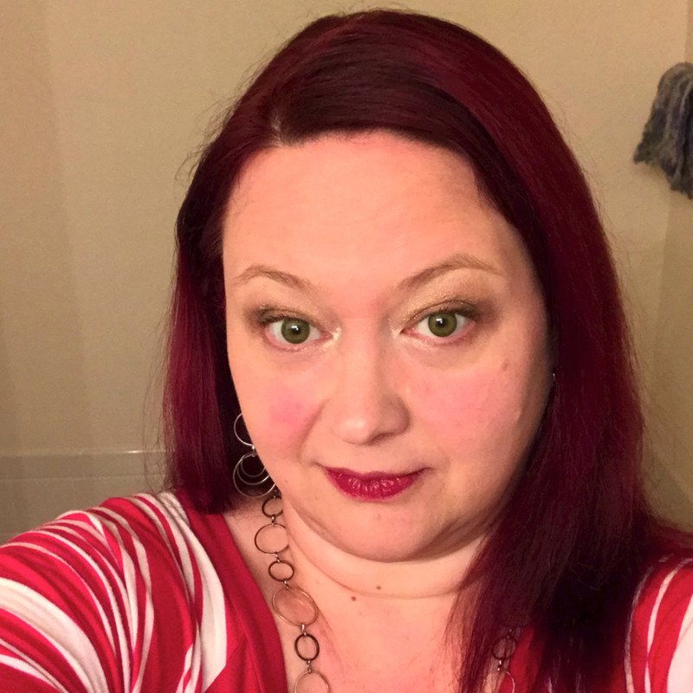
Kari’s Mission
Keep Systems up and responsive
Avoid fire drills in the off-hours
Avoid unnecessary escalations
(Is tired of everyone making security exclusively her problem)
Kari
Systems
Engineer

Slide 45
Kari’s Security Mindset
Keep systems and appliances secured and patched
Strictly follows least privilege
Adopt automation
Implement a highly responsive posture for infrastructure requests to prevent workarounds that compromise security
Kari
Systems
Engineer

Slide 46
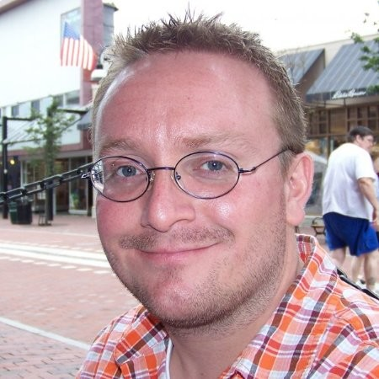
Michael’s Mission
Create high quality product
Leverage his expertise in Quality Assurance to focus on the important
Automate the manual QA functions
Squash Bugs
Michael
Quality
Engineer

Slide 47
Michael’s Security Mindset
Create tests focused exclusively around security
Learn open source tools like ZAP for vulnerability testing
Automate functional tests and introduce new tooling to assist with this if there are none.
Teach others the Shift-Left principles
Michael
Quality
Engineer

Slide 48
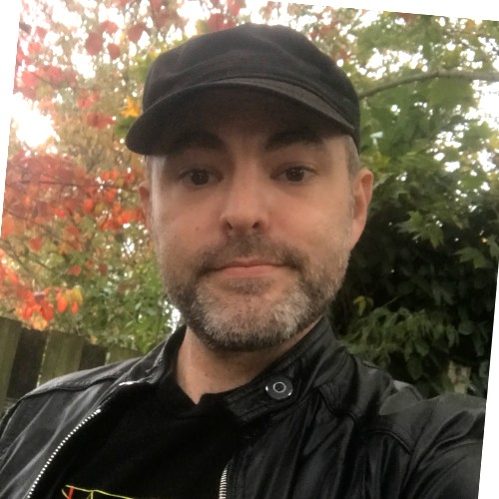
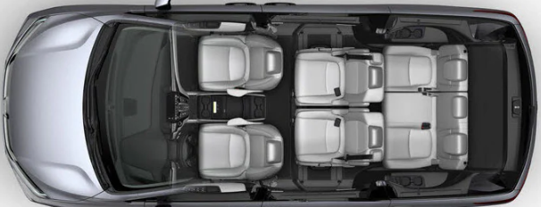
Steve’s Mission
Create high quality product
Use the latest tech
Avoid manual work (like Manual QA)
Just code
Steve
Software
Engineer

Slide 49
Steve’s Security Mindset
Follow secure coding practices
Be rigorous in code reviews
Do not use old or vulnerable libraries
Support the goal and implementation of shift-left
Instrument code to enable auditing
Steve
Software
Engineer

Slide 50
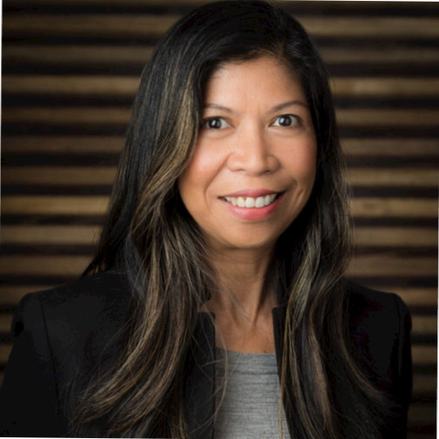
Carmina’s Mission
Make money for the organization
Avoid cost where practical
Reduce organizational risk
Protect the company’s IP
Support her employees/associates
Carmina
Leader /
Executive

Slide 51
Carmina’s Security Mindset
Seek to understand security initiatives
Seek to understand risk and appropriate risk responses
Identify where risk will be accepted
Help relate the expense of security practices to the potential cost of loss
Plan and budget for ongoing security initiatives and training
Carmina
Leader /
Executive

Slide 52
Your Mission
Work for a successful organization
Be valuable to your organization
Expand your skillset
Improve your organization’s security posture
You
Team Member

Slide 53
Your Security Mindset
Champion security on your team
Stay current on best practices
Review team processes for least privilege and separation of concerns
Hold other teams accountable
Introduce / Own Threat Modeling
Log all decisions/actions
You
Team Member

Slide 54
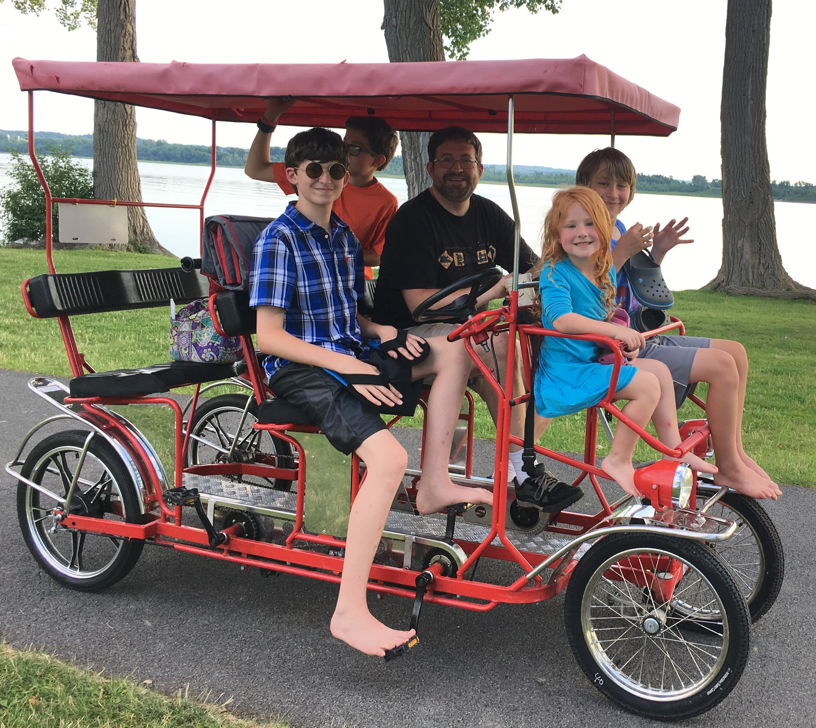
Road Trip Lesson #4
The more the merrier
Notes:
Shoes optional

Slide 55
Plan a Route
5
(but allow time for detours)

Slide 56
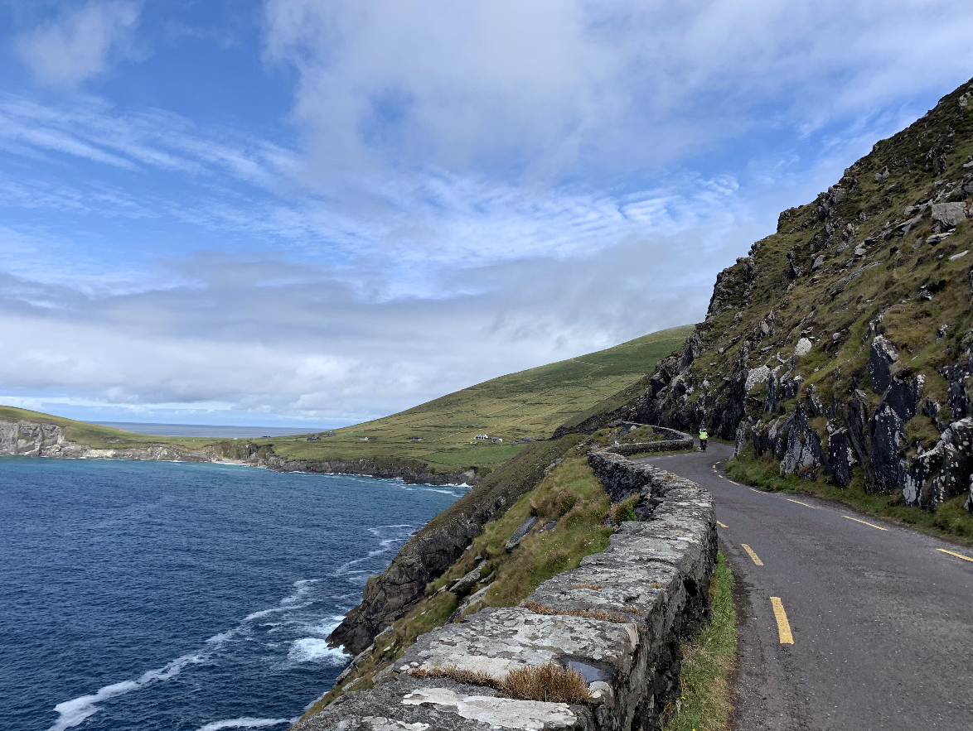
The Plan
The road to a Security Mindset.

Slide 57
It’s a long, curvy road, but there are scenic overlooks (and pit stops!)
Start Now
Start Simple
Security in Design
Educate Everyone
Make it Easy
Define WIIFM
Set Goals
Take Ownership
Notes:
Thanks for humoring me here.

Slide 58
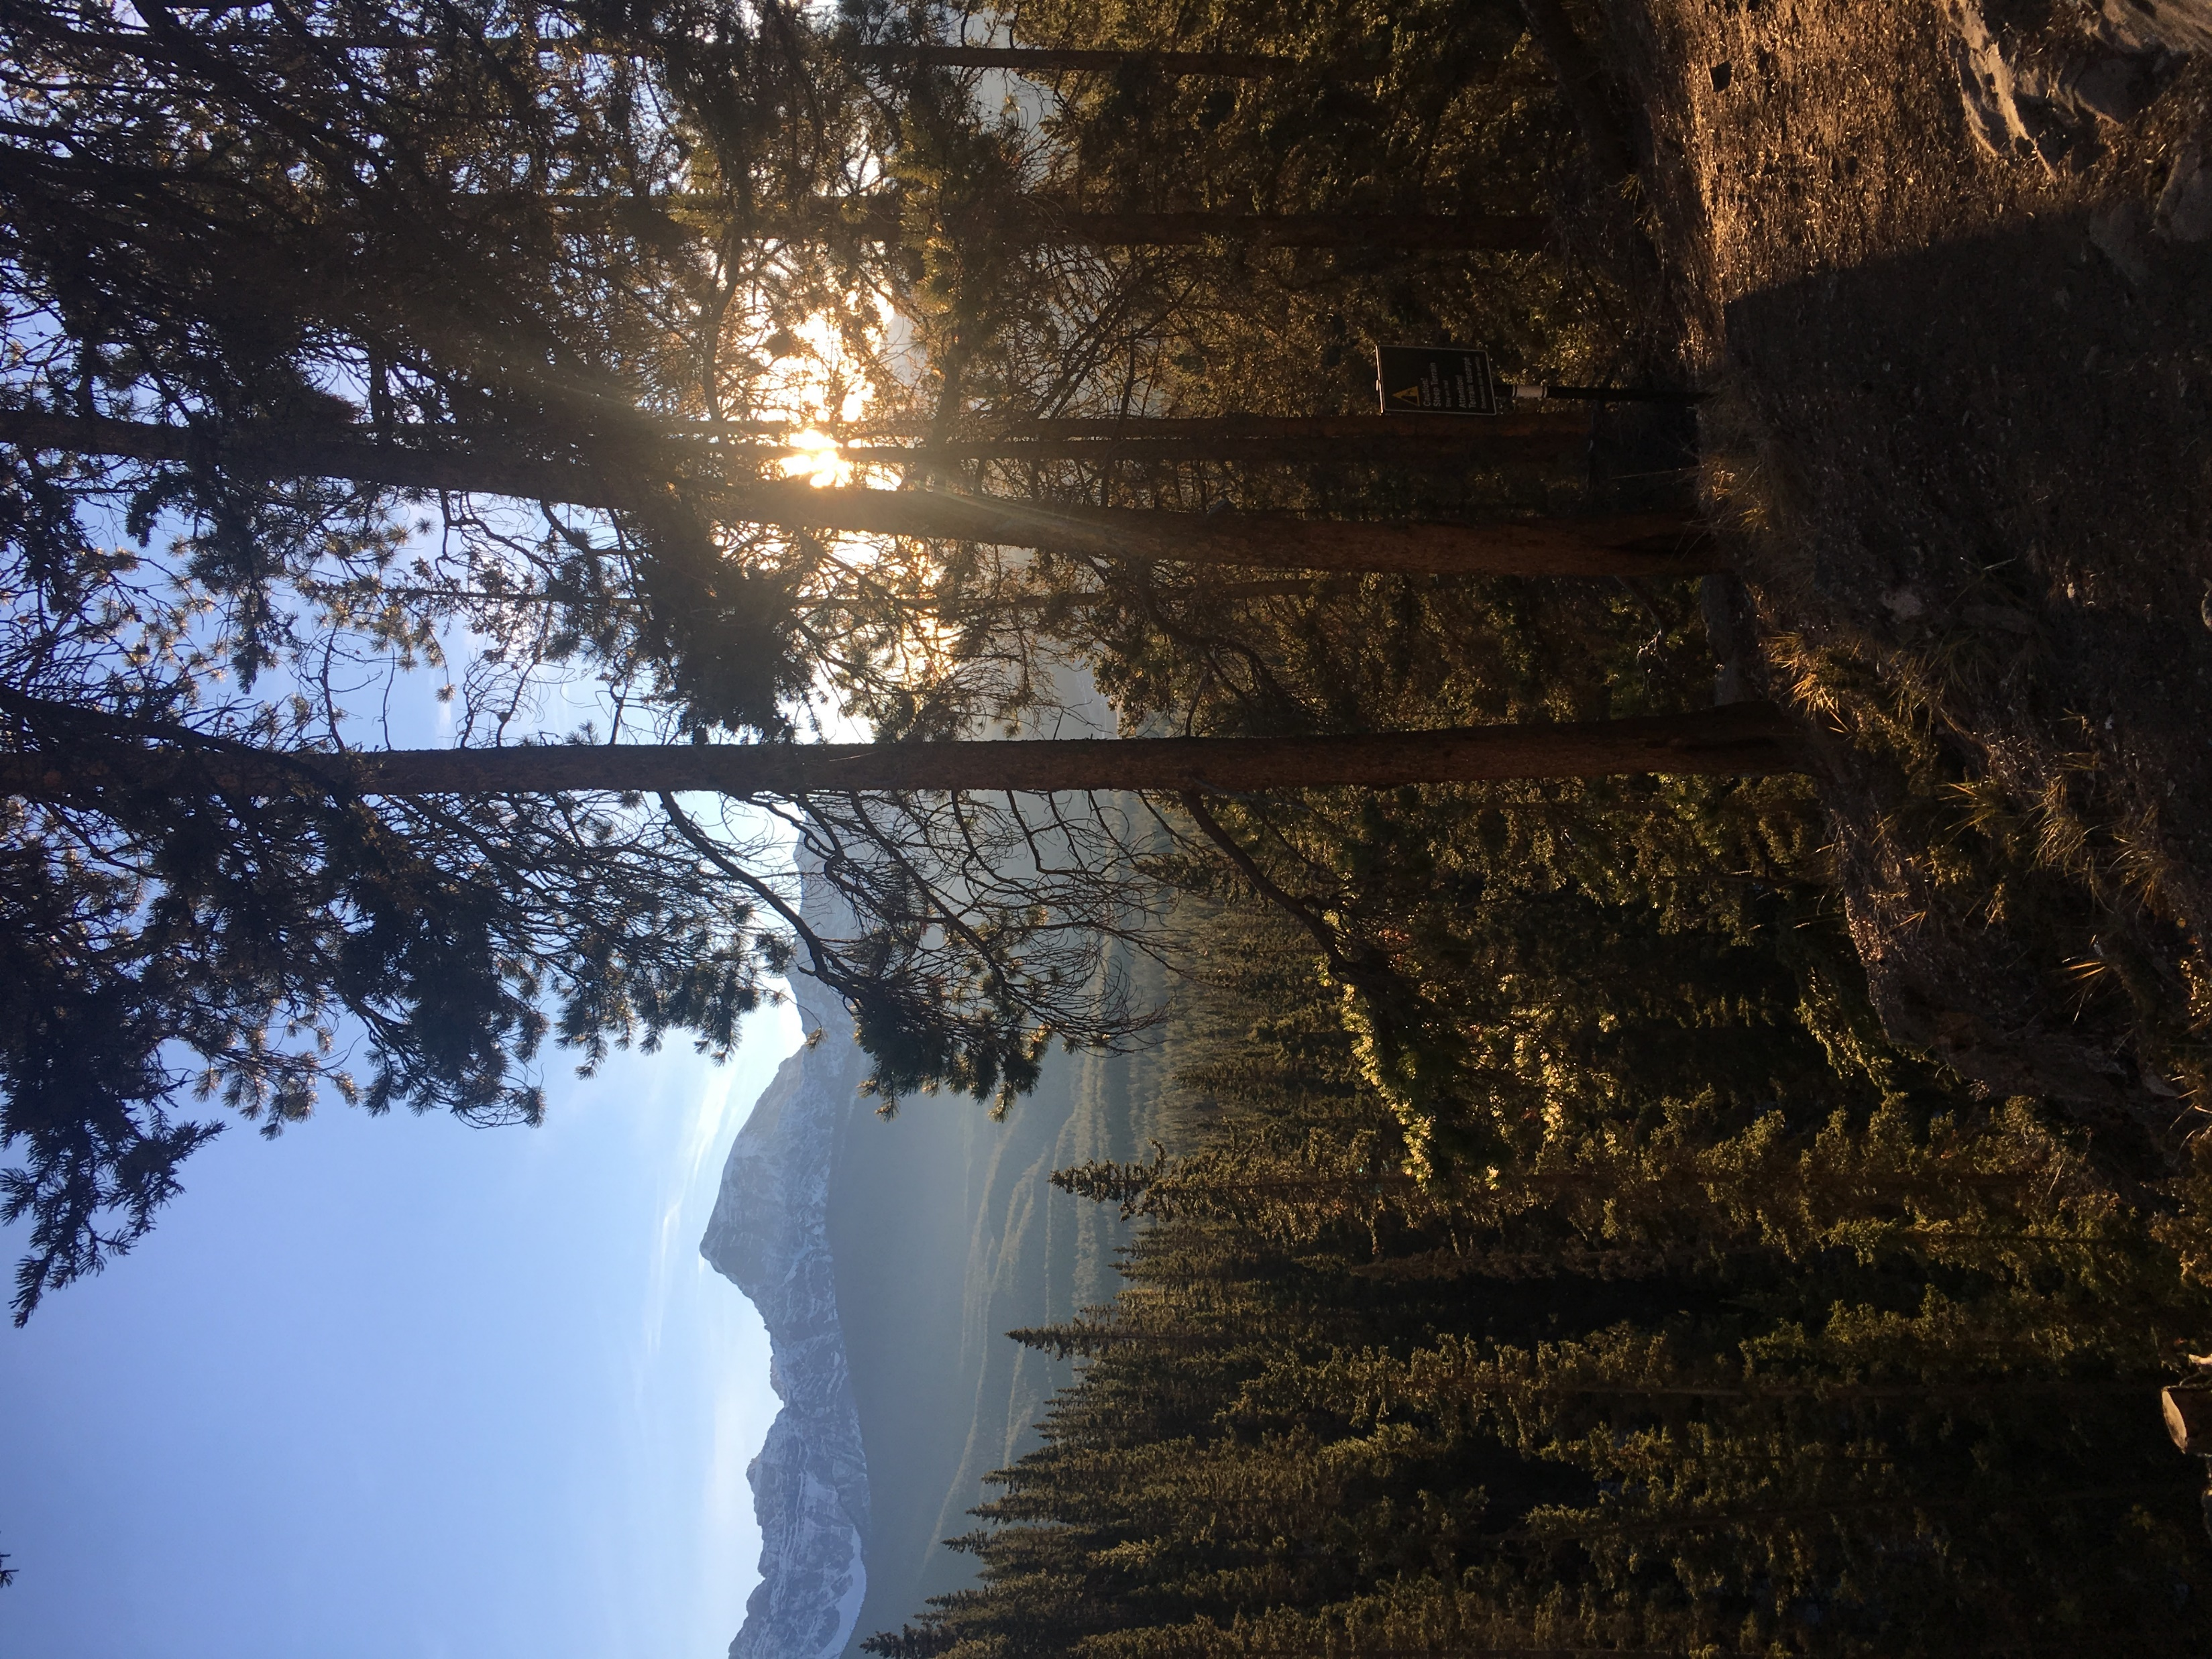
Awareness is Critical
We don’t know enough
Our applications are targets
We can’t make assumptions
It’s everyone’s job
Defects are security holes
We can’t secure what we don’t test
Security features are not enough
Notes:
New vulnerabilities every day – none of us know it all
Like we saw on the car ride, just because it’s illegal doesn’t mean people won’t do it. Just because people should rotate passwords doesn’t mean they will. We can’t make assumptions about our users, our usage. Don’t assume…
Defects are security holes – how do you know that a defect in your application cannot be used to compromise it? You don’t. If it’s not working correctly, then it’s an opportunity.
Along with that, if we can’t test something (or we don’t test it regularly) we can’t be certain it’s secure
Like we saw with the camera, security features like cameras, firewalls, intrusion detection systems, using SSL are not enough
We are creating modern, web-enabled applications for consumers or for large organizations. They are potential targets. And if we’re not securing them properly, they are the most interesting targets.
Lastly, it’s everyone’s job. We saw in our case study failures at every level. It truly is a weakest link scenario.

Slide 59
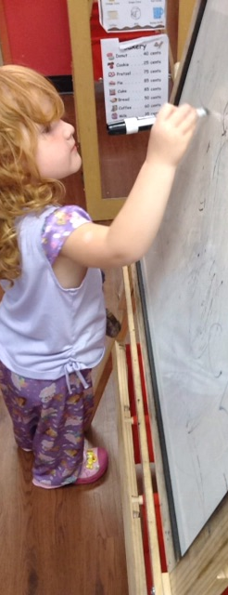
Start Early – Security in Design
Quality Attributes / Gates
Security Features / Secure Features
Widespread logging and auditing
Threat Modeling
Robust Version Control and Code Review Process
Robust Component/Third Party Library Process
Notes:
Next on our path is Starting early in our process by bringing security in Design.
We talked about establishing those quality attributes and gates.
We need to keep including the security features in our design but also design for them to be Secure features as well.
Bring threat modeling in early. Before we’ve written any code. Design the system and poke holes in it and look for opportunities to improve the security posture.
Make sure that, from the start, we have robust version control and code review processes in place. From the start. Again before any code is written. Otherwise you’ve got possible flaws in there that no one cares about until they become a catastrophe.
And make sure there’s a clear agreement on how we are going to be bringing outside libraries into our code. How will we vet them? How will we know what we are using? From the start.

Slide 60
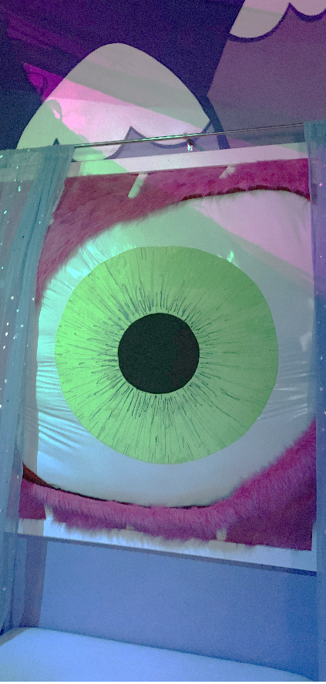
Threat Modeling
Diagram the System or a Feature
Adopt an attacker mindset
Try to find ways to compromise it
Write up findings
Prioritize findings against acceptable risk
Mitigate

Slide 61
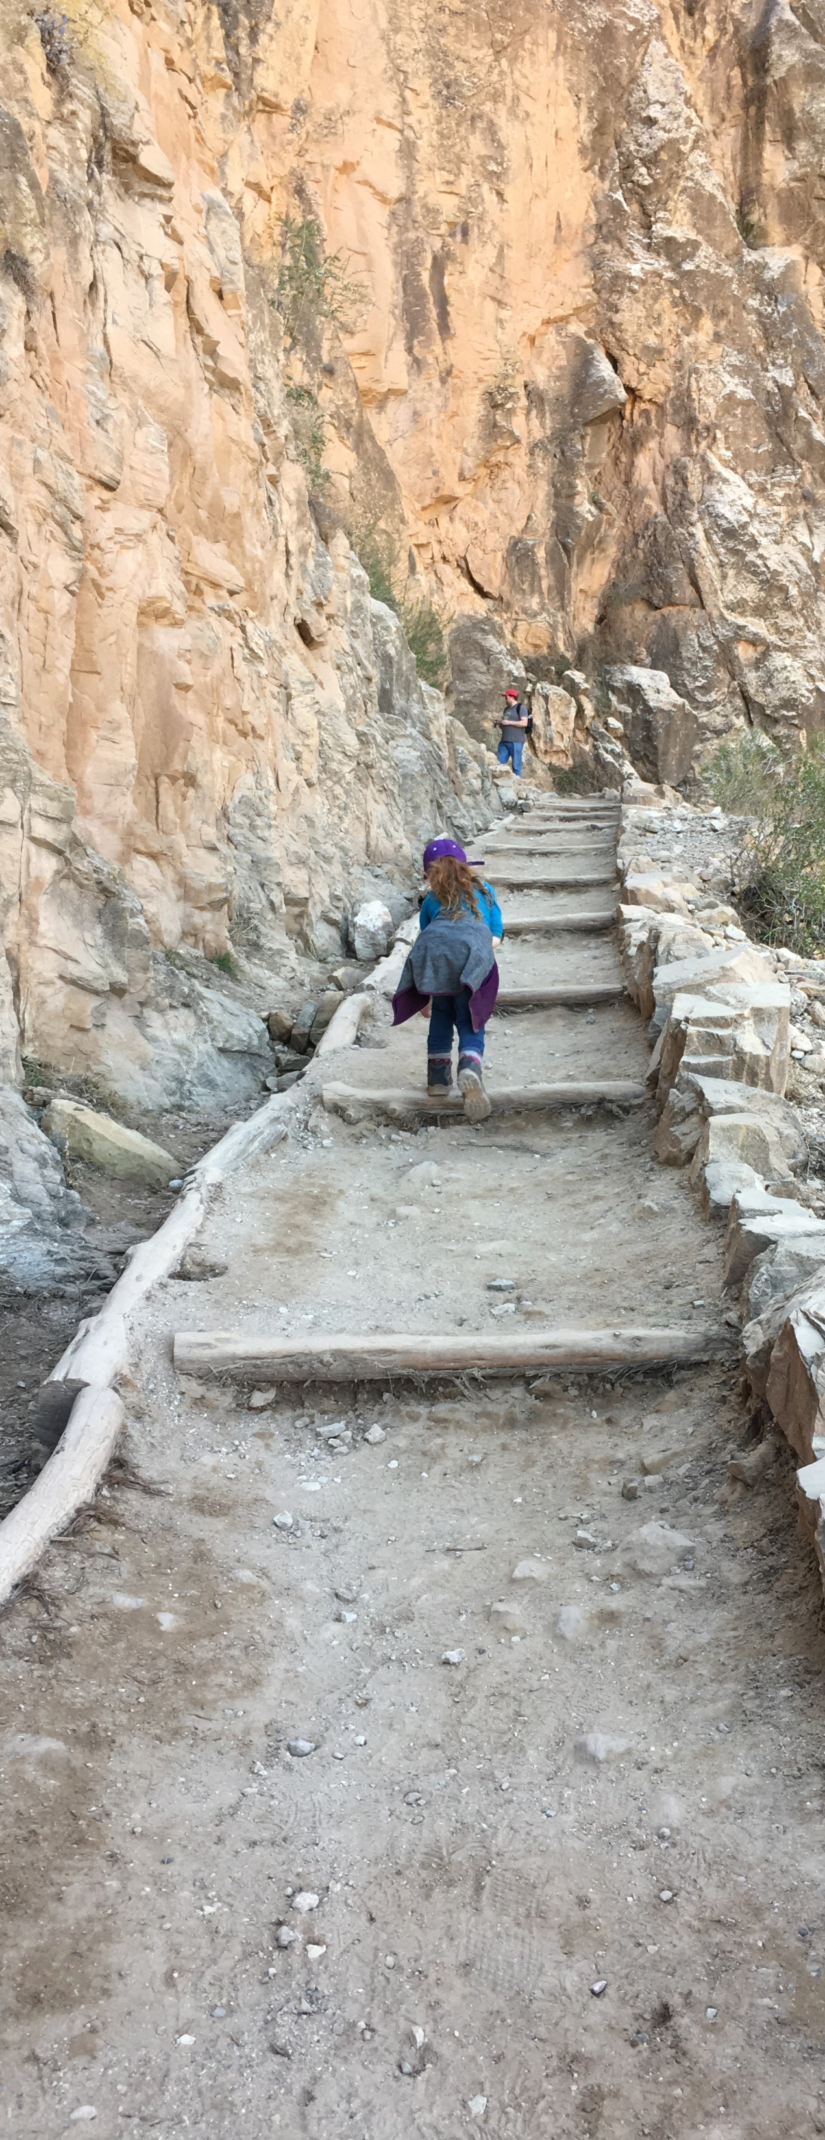
Set Lofty Goals
Define Quality Attributes
Establish Measures of Success
Maintain High Ideals
Keep Persisting
Don’t lower the bar
Notes:
Quality Attributes - What does great look like? What is ideal-case for this application for security?
Measures of Success – How do we know we’re getting better? code coverage %, defect ratio, frequency of vulnerability scans, resolution timelines.
Keep those high ideals. Keep the bar high but be happy with all wins
Lastly, Persistence is critical. Keep going
And Remember….

Slide 62
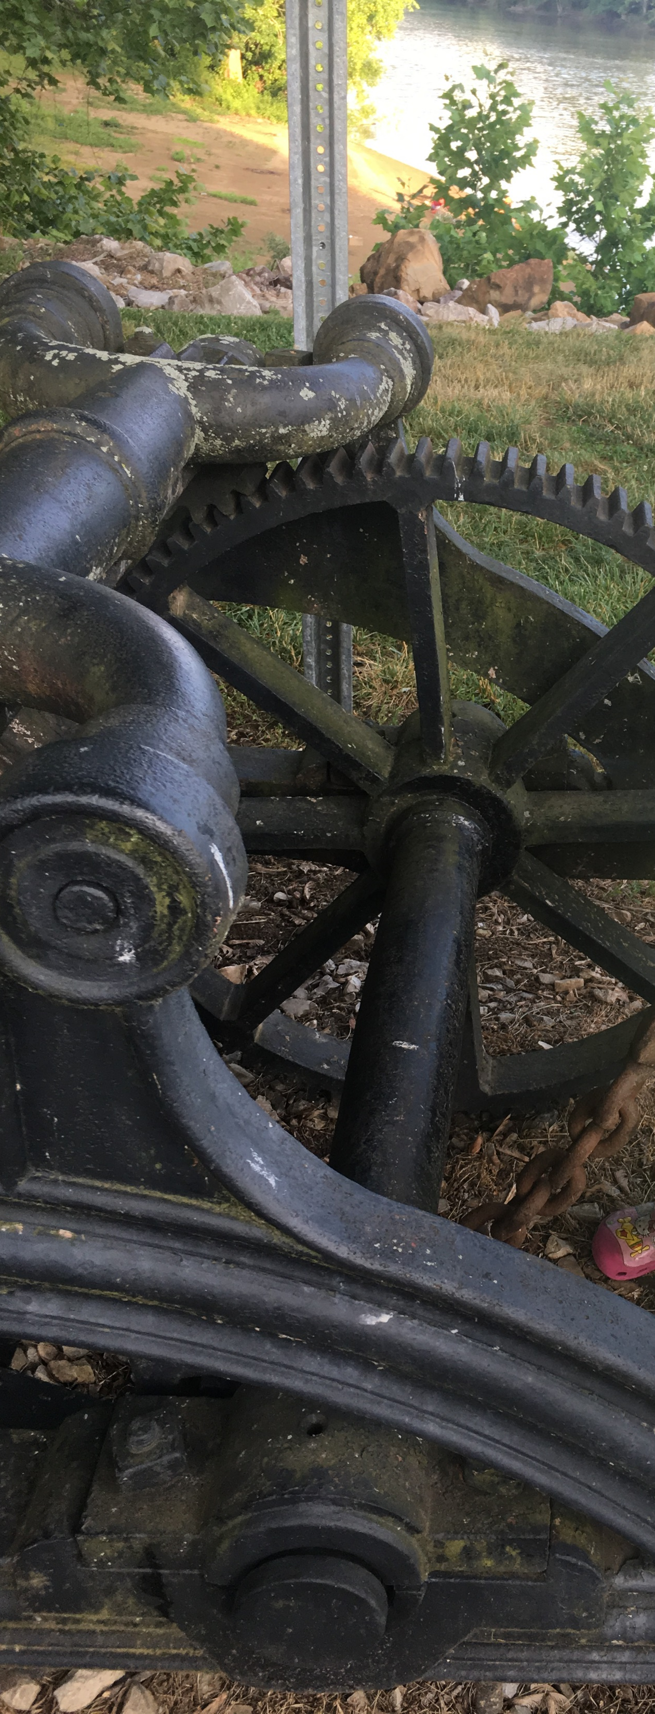
Shift Everything Left
Build quality and security into the pipeline
Unit Tests
Integration Tests
Code Coverage
Functional Tests
Vulnerability Tests
Package Scanning
SAST / DAST / IAST (Static/Dynamic/Interactive Security Testing)
Catch Issues Earlier
Notes:
Shift it all left. If you aren’t familiar with the Shift-Left phrase it means that you try to catch as many issues as early as you can because it is cheaper to fix problems earlier in our processes.
Look into building these quality gates into our CI pipeline. Fail builds. Measure code coverage in the pipeline. “We do unit tests” I think our coverage is around 70. You think? You should know the minimum. Set the bar, and don’t move it. Fail the build if you fall below it.
Add regression tests to the pipeline if you can.
How about vulnerability tests even? Or scanning for packages? Or code analysis?
All of this could be added into the pipeline with varying levels of complexity.
The main objective is …

Slide 63

Start Simple
Target what you can control
No external dependencies
Great Starting Areas:
Threat Modeling
Internal Processes
Quality Attributes
Notes:
Shifting everything left is a lot but really my recommendation is to start simple and build on it.
And really, if we’re just starting (or we’re re-starting), we need to start simple.

Slide 64
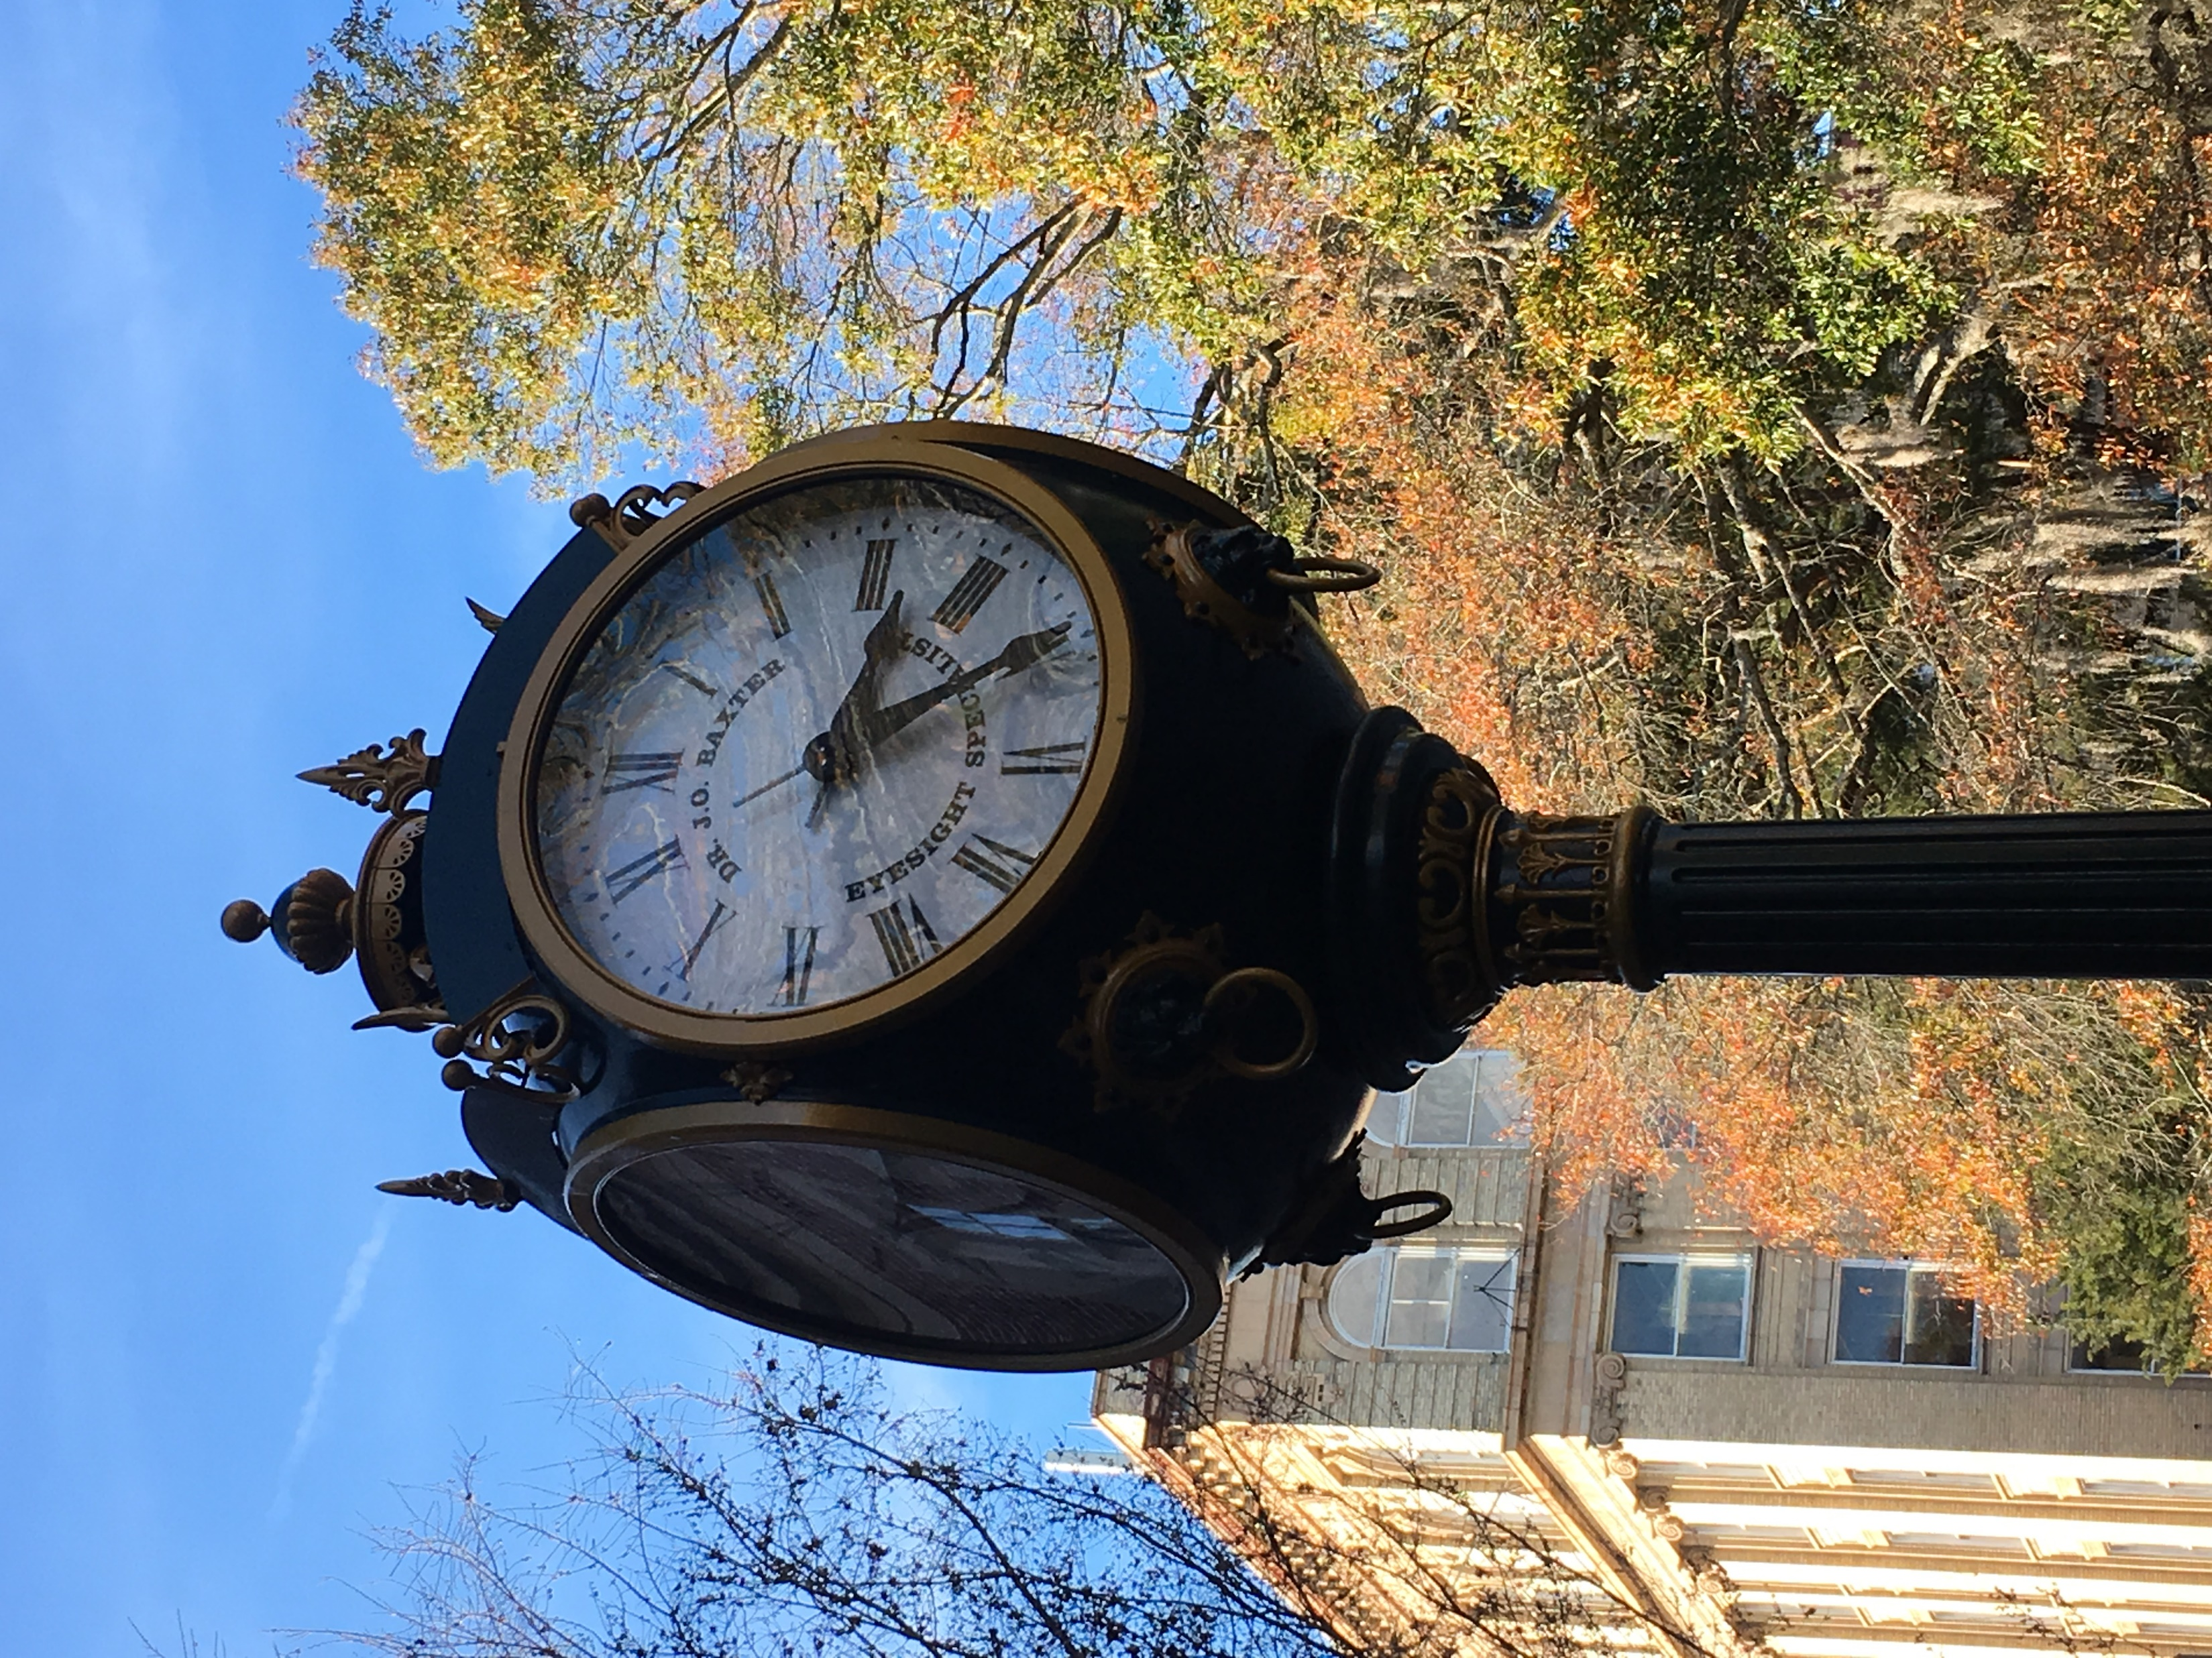
Start NOW
Start early if you can
Start now if you can’t

Slide 65
Road Trip Lesson #5
The earlier you start the earlier you arrive.

Slide 66
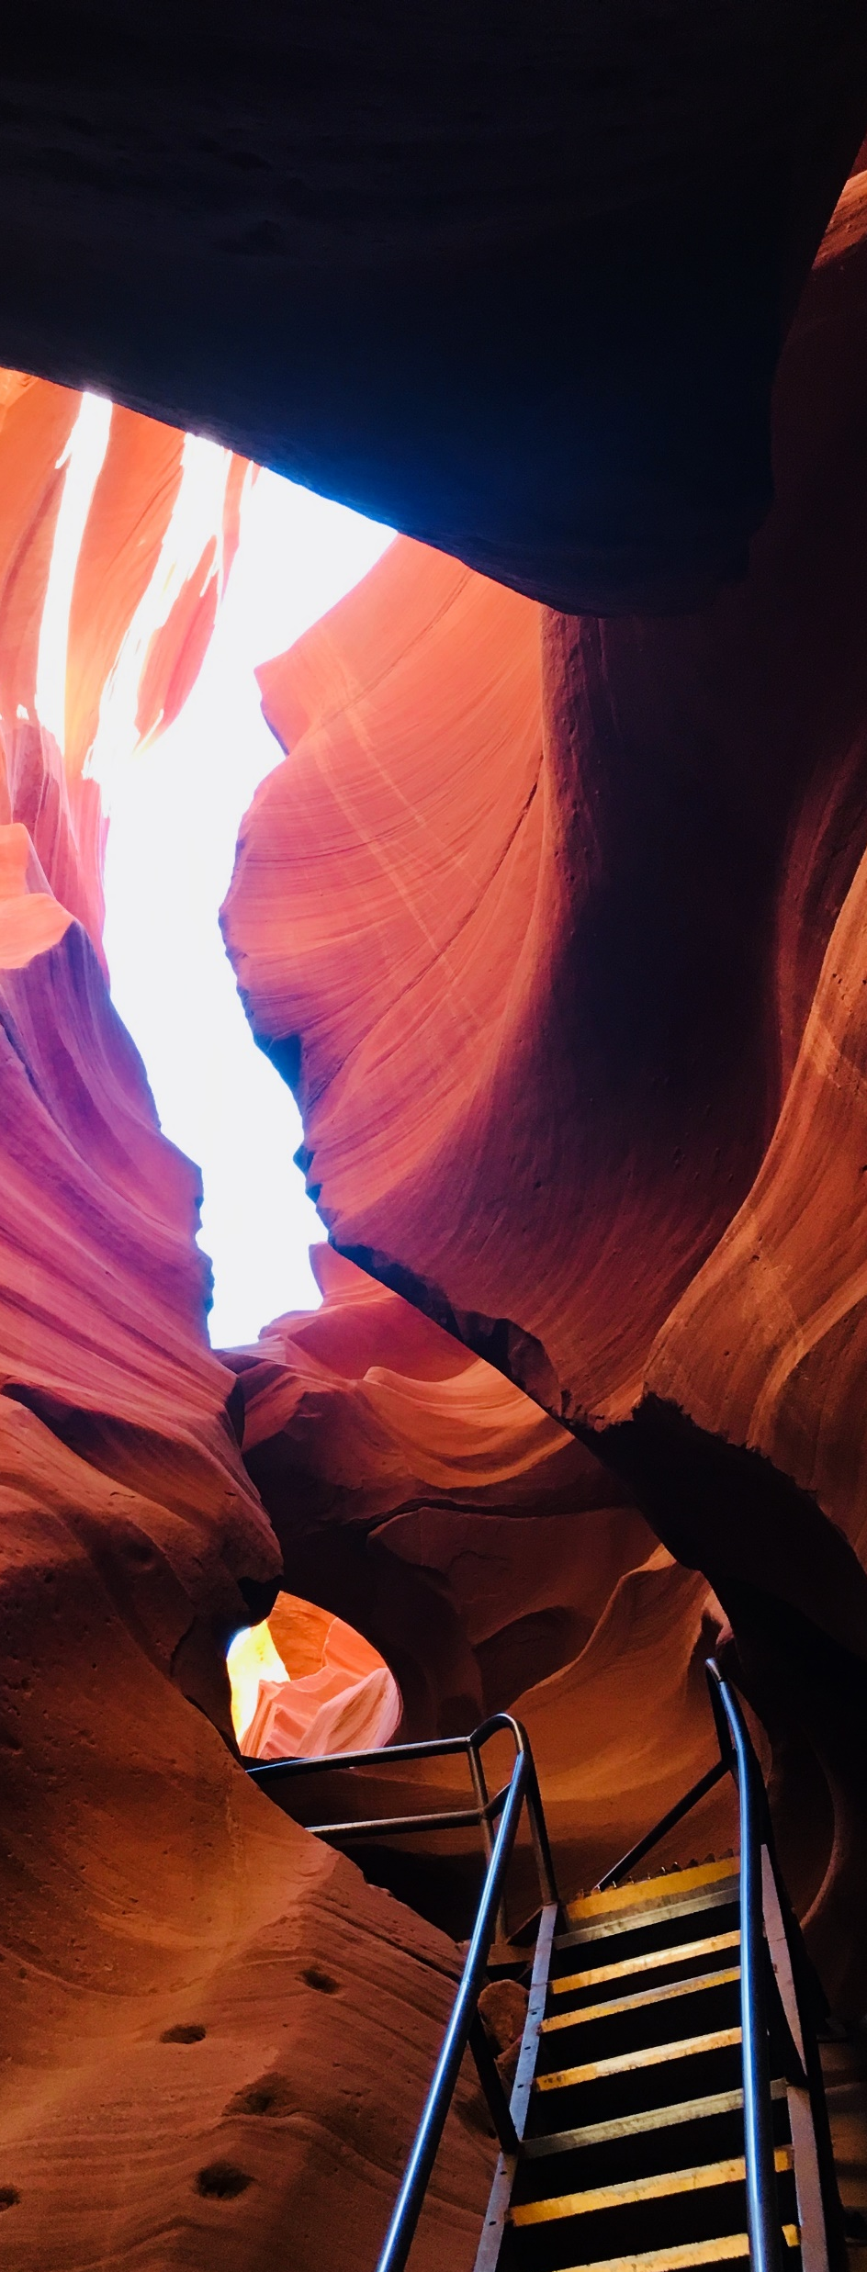
Start where you are. Use what you have. Do what you can.
*Arthur Ashe

Slide 67

Thanks for listening!
https://github.com/apcacher/codemash2020
@apcacher
apcacher

Slide 68
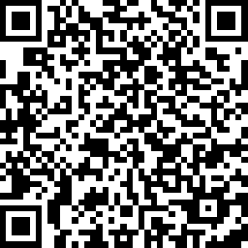
Help Me!
Please take my survey:
https://www.surveymonkey.com/r/HCFXWYH

